Slide 1
DSCI 6007-01 Distributed & Scalable Data Engineering-Final Project Team08
Comprehensive Analysis of Real Estate Market
Notes:
For Educators: You can use this template to help your students effectively present and communicate their project to a broader audience. Your students can also use this presentation as a portfolio of their work to demonstrate their cloud skills.
The presentation structure is listed below. The total time may vary depending on the activity you want to conduct. For example, you may want your students to provide high-level walkthrough of their final solutions versus deep-dive into why or how they chose certain services and the steps of building their architectures.
Suggested timing for a 15-minute presentation:
Introduction – 30 seconds
Business scenario overview – 1 minute
Solution overview – 5 minutes
Architecture diagram of the solution – 2 minutes
Demo – 5 minutes
Lessons learned – 1.5 minutes

Slide 2



TEAM
Sai Siddu Vardhan Reddy Annadi
Team Leader(Data Scientist)
Vinay Kumar Reddy Punuru
(ML Engineer)
Shiva Priya Pillalamarri
(Data Engineer)

Slide 3

Business scenario overview
The residential real estate market has traditionally been driven by factors such as property size, amenities, location, and neighborhood characteristics. However, the COVID-19 pandemic has introduced new dynamics that have significantly shifted buyer and investor preferences. Remote work, the desire for suburban living, and the need for proximity to health facilities, parks, and recreational spaces have altered property demand. This shift presents both a challenge and an opportunity for real estate developers, investors, and policymakers to align their offerings with changing consumer needs. Failure to adapt to these trends could result in a loss of market relevance, while proactive adaptation could unlock new growth opportunities in emerging residential markets.
Notes:
Define the problem or opportunity that you are addressing. Include pictures, figures, and statistics to help the audience better conceptualize the problem or opportunity.
Specify who your users or customers are and what pain points they are experiencing.
For example: “Users complain that the student admissions department website is too slow and isn’t always available.”
Also, list any specific business requirements that you are addressing.
For example: “Improve the experience for users. The web application can be deployed to the AWS Cloud. The application must be highly available, scalable, load balanced, secure, and performant architecture that can support thousands of users.“
Note:
An above-bar overview succinctly defines the problem and opportunity statement. For example: “Customers with media files, such as retail companies, need an easy and cost-effective way to analyze photos and videos of their inventory.”
A below-bar overview is too verbose, technical, or not specific. For example: “The most common media files are .jpg and .mp4. Companies have media files of their inventory.”

Slide 4
Solution overview
This project aims to identify the key factors influencing residential property prices, including the impact of COVID-19, using the CAMA dataset from Open Data DC. By employing the CRISP-DM methodology, the project will explore property characteristics, neighborhood factors, and proximity to city centers to analyze price variations. Multilevel modeling will be used to evaluate differences in residential complexes while answering specific questions on gross building area changes, the impact of COVID-19, and correlations between bedrooms and sale prices. The project will leverage data science tools and GitHub for collaboration to derive actionable insights.
Notes:
Explain at a high level what you have built.
For example: “I built a web application for a company to host their blog.“
Talk about why you chose certain parts of the solutions and any tradeoffs that you made. Focus on how you designed the solutions and how you applied the AWS Well-Architected Framework as part of the process (AWS Well-Architected Framework: https://docs.aws.amazon.com/wellarchitected/latest/framework/welcome.html).
For example: “I configured load balancers and auto scaling to make the application highly available and reliable.”
Include the use cases that you are addressing. Think about who your users are and how they would want to interact with your solution to solve their problem.
For example: “Users can view, upload, edit, and delete blog posts. Administrators can approve blog posts.”
Talk about the use cases that you addressed as part of the minimum viable product (MVP) that you scoped and built.
Note:
An above-bar description is concise and includes the most important benefits. For example: “The solution allows customers to quickly upload, store, and search large catalogs of images and videos in Amazon S3.”
A below-bar description is too detailed or not specific. For example: “Our solution analyzes media files.”

Slide 5

CRISP-DM Methodology
Notes:
Use the following resources to create a diagram of your application architecture:
AWS Architecture Icons at https://aws.amazon.com/architecture/icons. This page includes diagram assets as well as links to drawing and diagramming tools that you can use.
As you walk through the architecture, make sure that you relate back to the business requirements and the AWS Well-Architected Framework (https://docs.aws.amazon.com/wellarchitected/latest/framework/welcome.html).
You can also go more in depth about the design considerations and trade-offs that you made.

Slide 6





Architecture diagram
CAMA Database
(ETL)
(Data Source)
Query
Prepared Data
(Model Deployment)
Inference
Notes:
Note: Remove this slide from your final presentation.
This example architecture diagram shows a solution to configure a webhook to link Git with AWS. You can find this example in the Toolkits for PowerPoint at https://aws.amazon.com/architecture/icons.

Slide 7
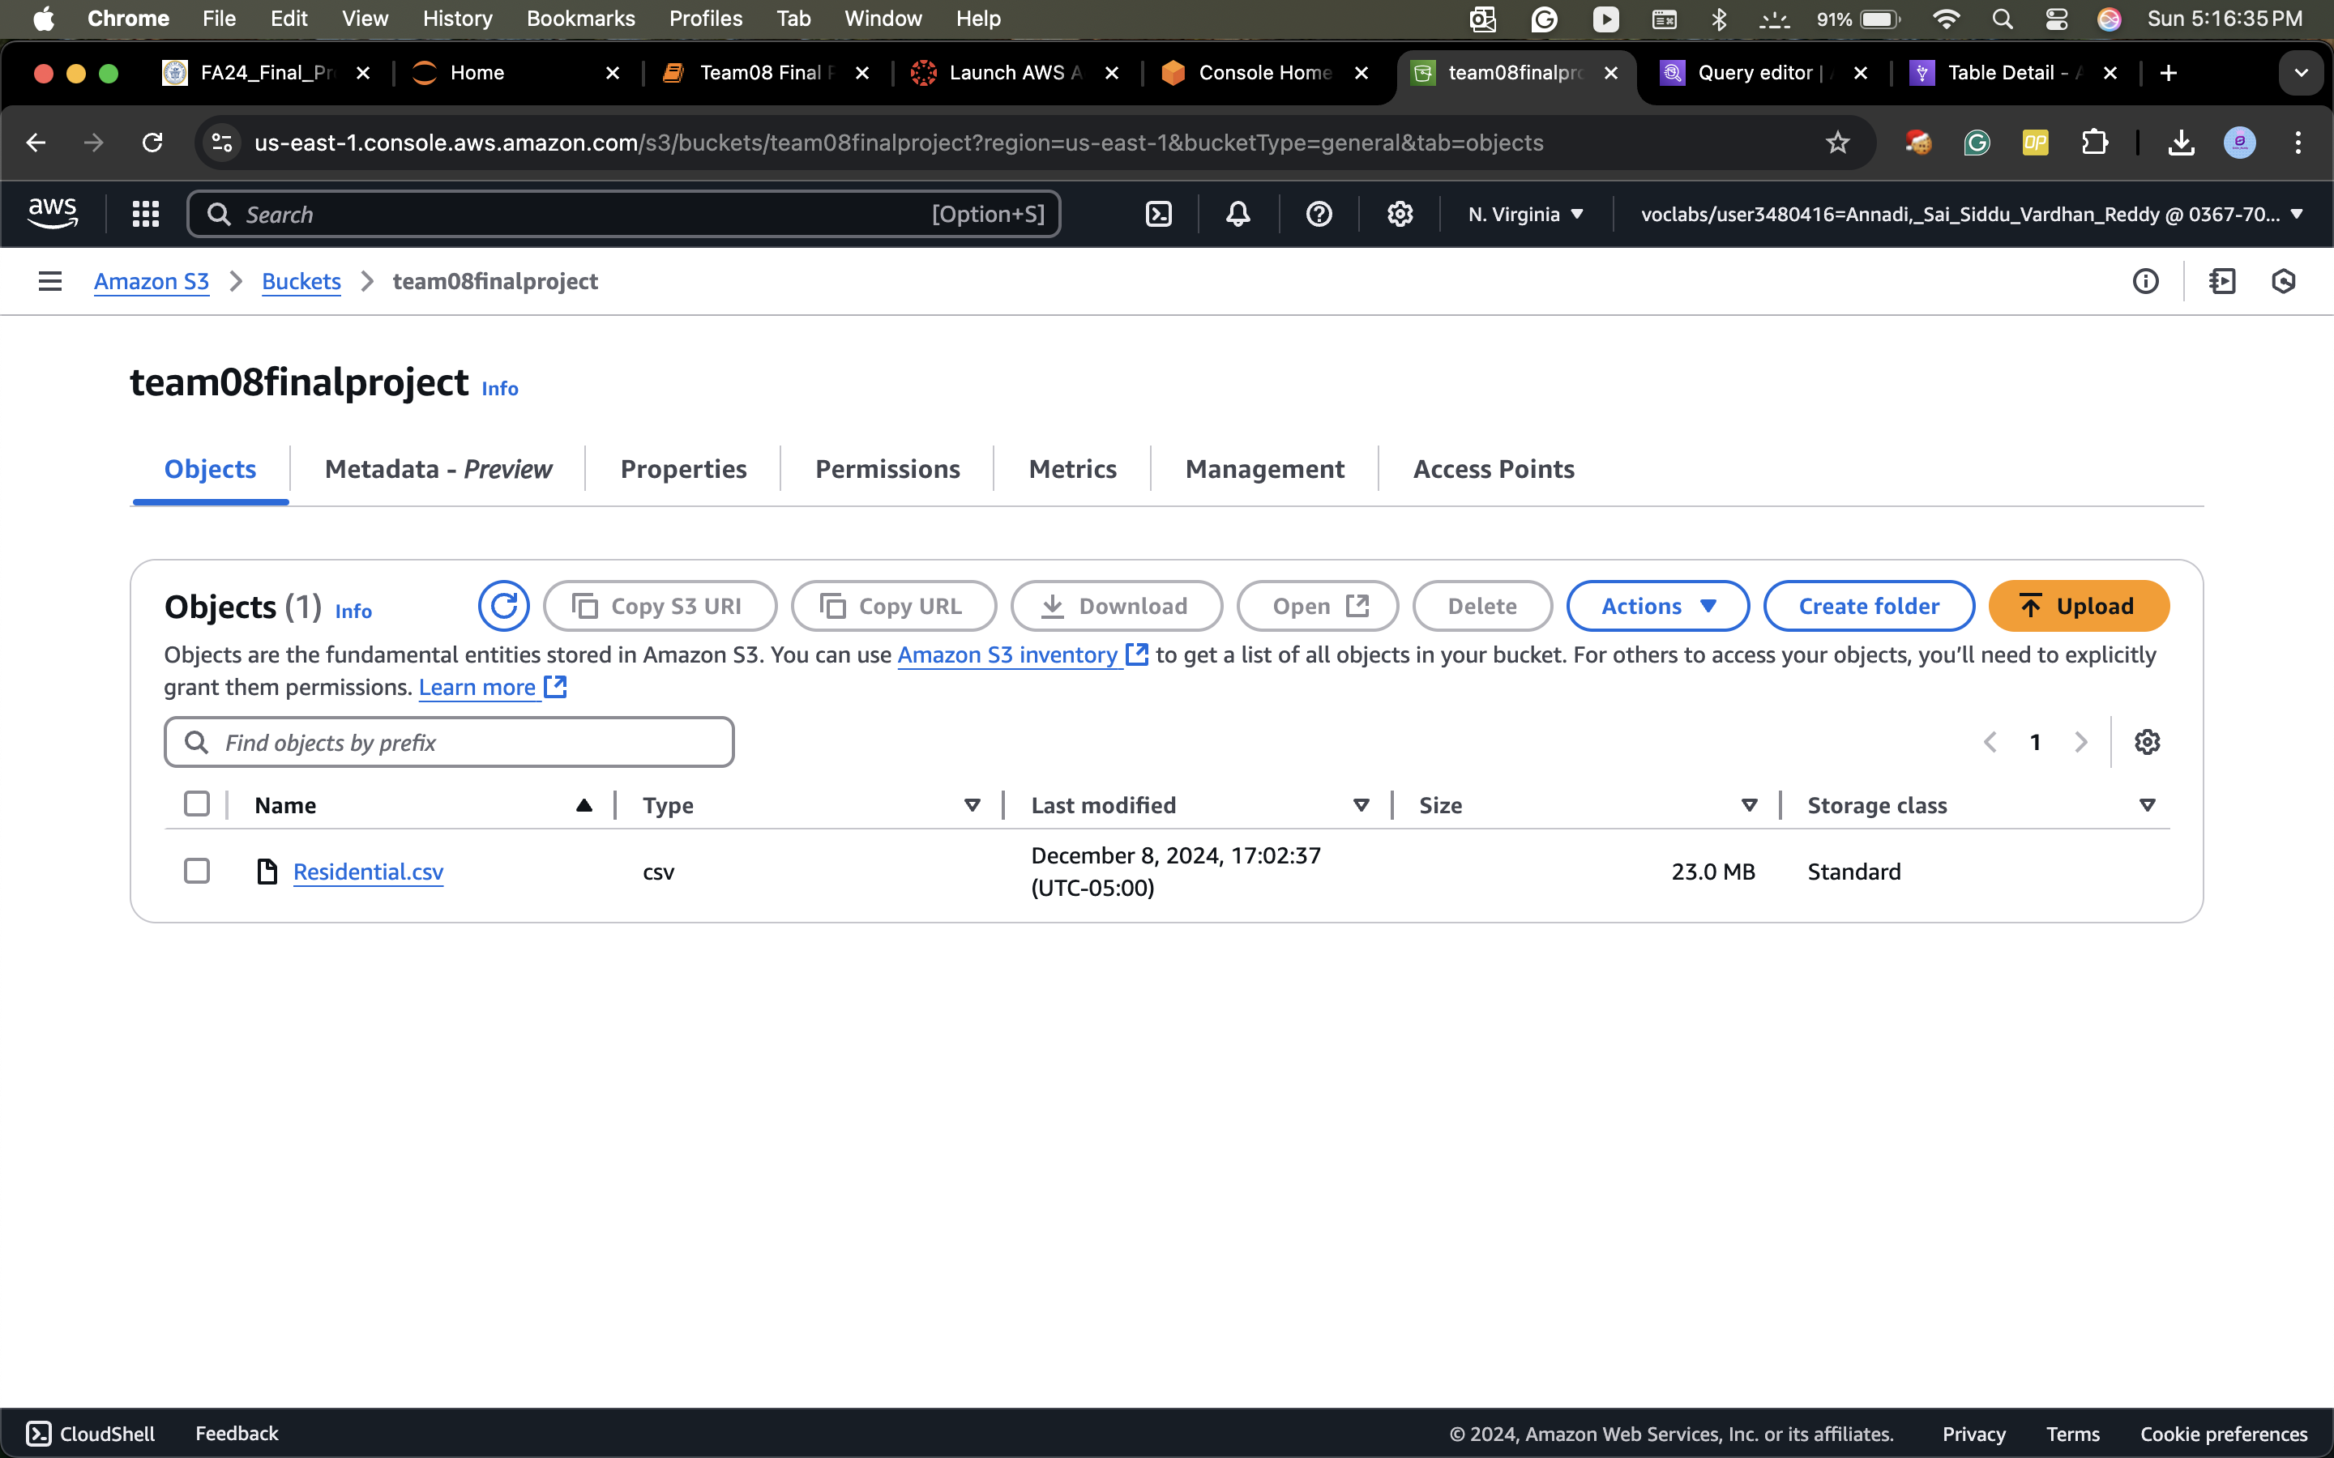
Loading the Dataset(CSV File) in S3:
Data Set: https://opendata.dc.gov/datasets/DCGIS::computer-assisted-mass-appraisal-residential/explore
Notes:
Note: Remove this slide from your final presentation.
This example architecture diagram shows a solution to configure a webhook to link Git with AWS. You can find this example in the Toolkits for PowerPoint at https://aws.amazon.com/architecture/icons.

Slide 8
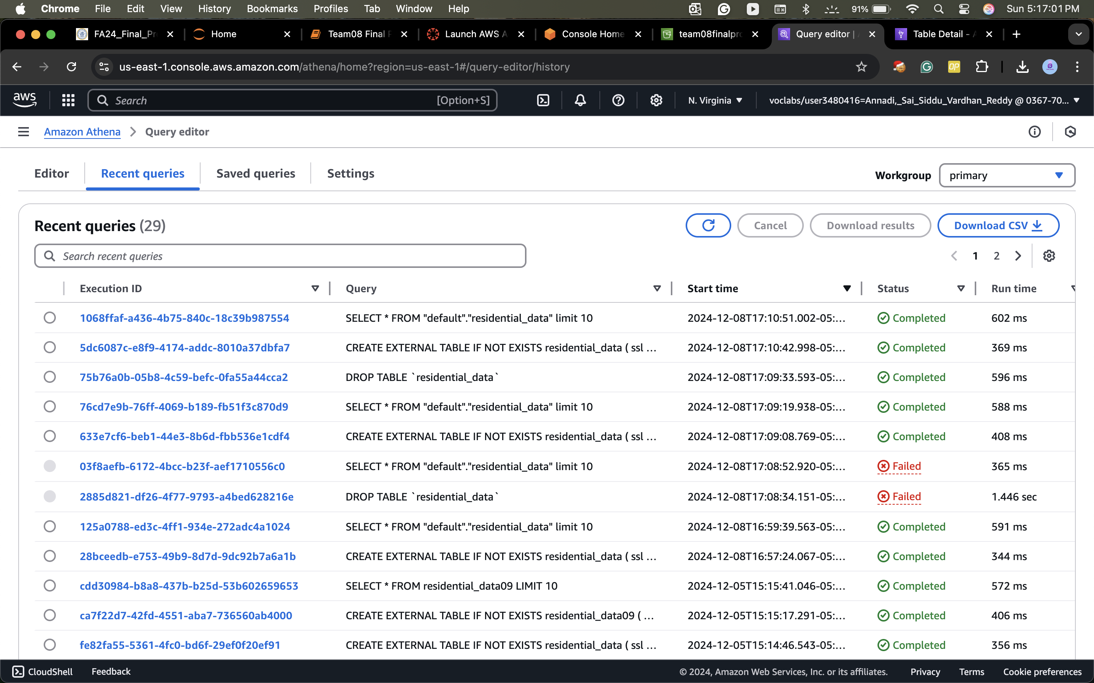
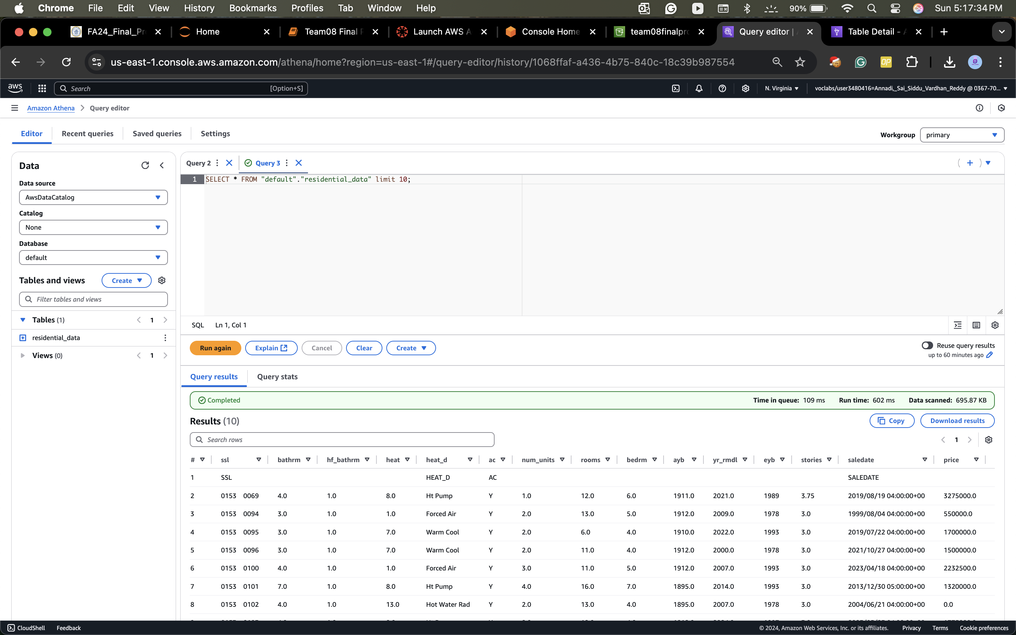
Understanding and Query Data Using Athena
Notes:
Note: Remove this slide from your final presentation.
This example architecture diagram shows a solution to configure a webhook to link Git with AWS. You can find this example in the Toolkits for PowerPoint at https://aws.amazon.com/architecture/icons.

Slide 9
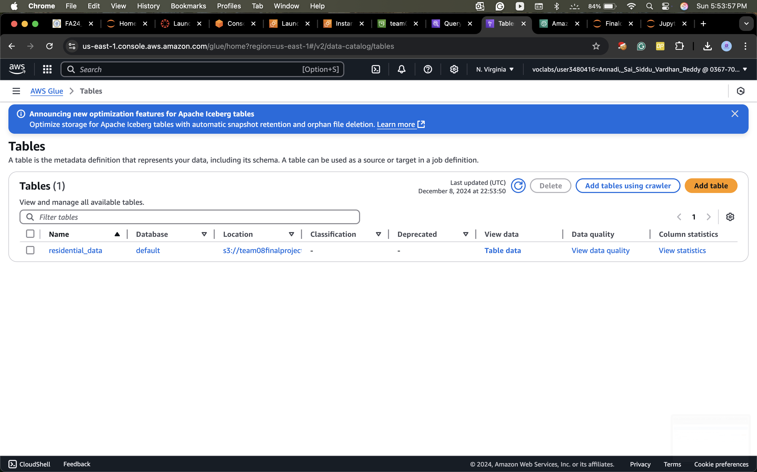
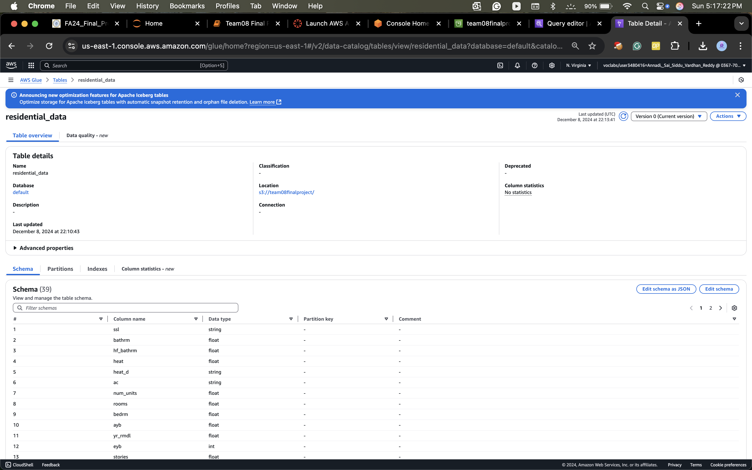
AWS Glue : Loading Data to Schema
Notes:
Note: Remove this slide from your final presentation.
This example architecture diagram shows a solution to configure a webhook to link Git with AWS. You can find this example in the Toolkits for PowerPoint at https://aws.amazon.com/architecture/icons.

Slide 10
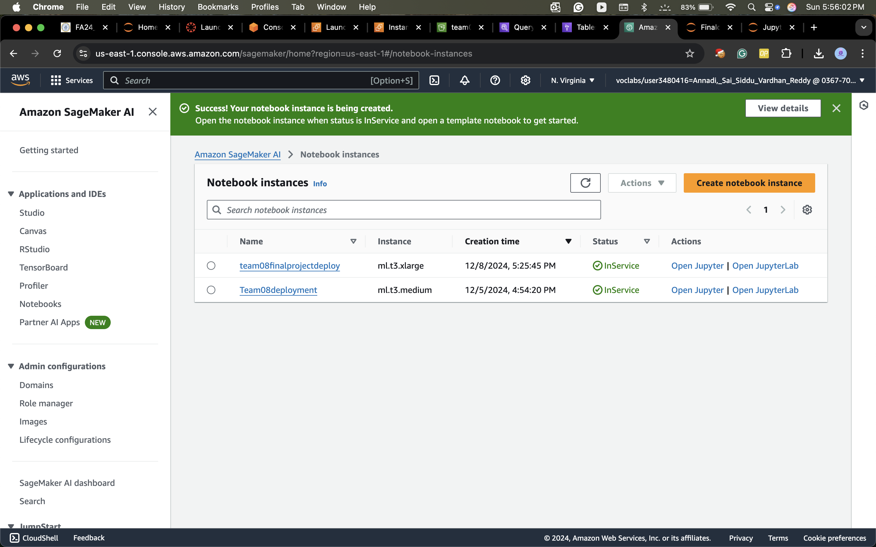
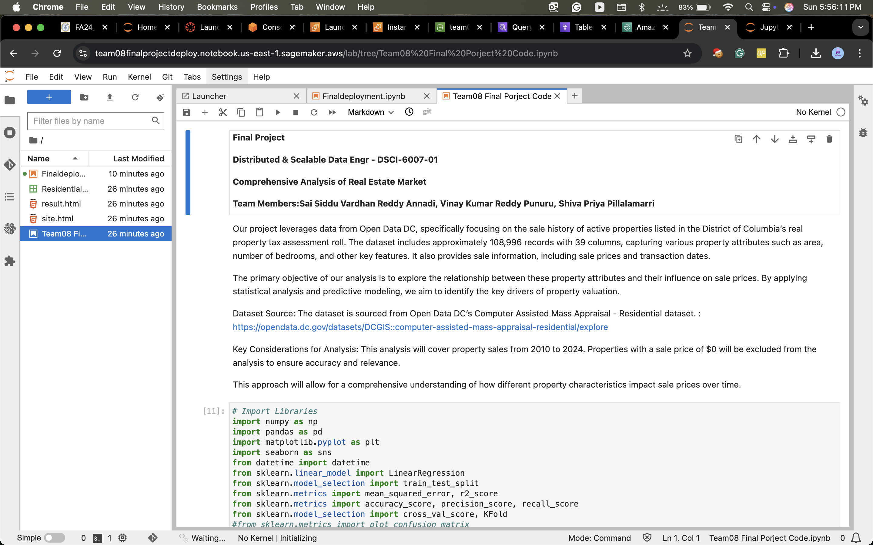
AWS SageMaker and SageMaker Notebook Instances
Notes:
Note: Remove this slide from your final presentation.
This example architecture diagram shows a solution to configure a webhook to link Git with AWS. You can find this example in the Toolkits for PowerPoint at https://aws.amazon.com/architecture/icons.

Slide 11
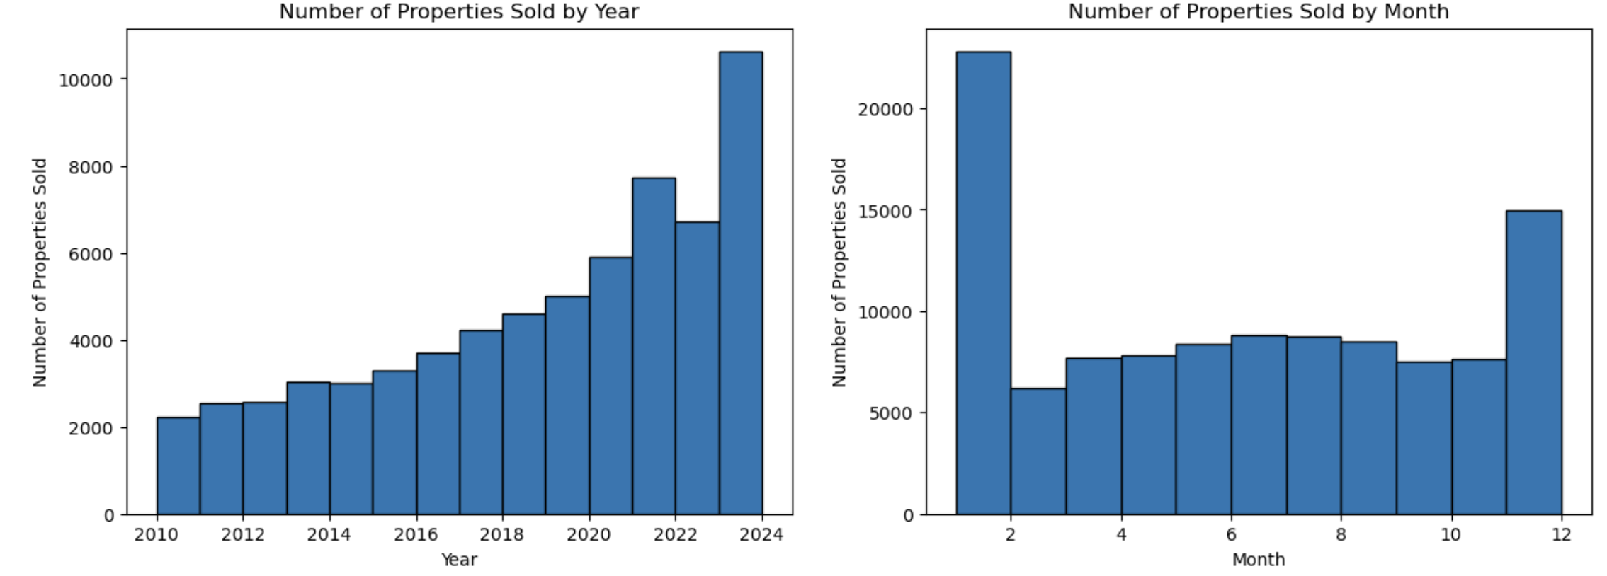
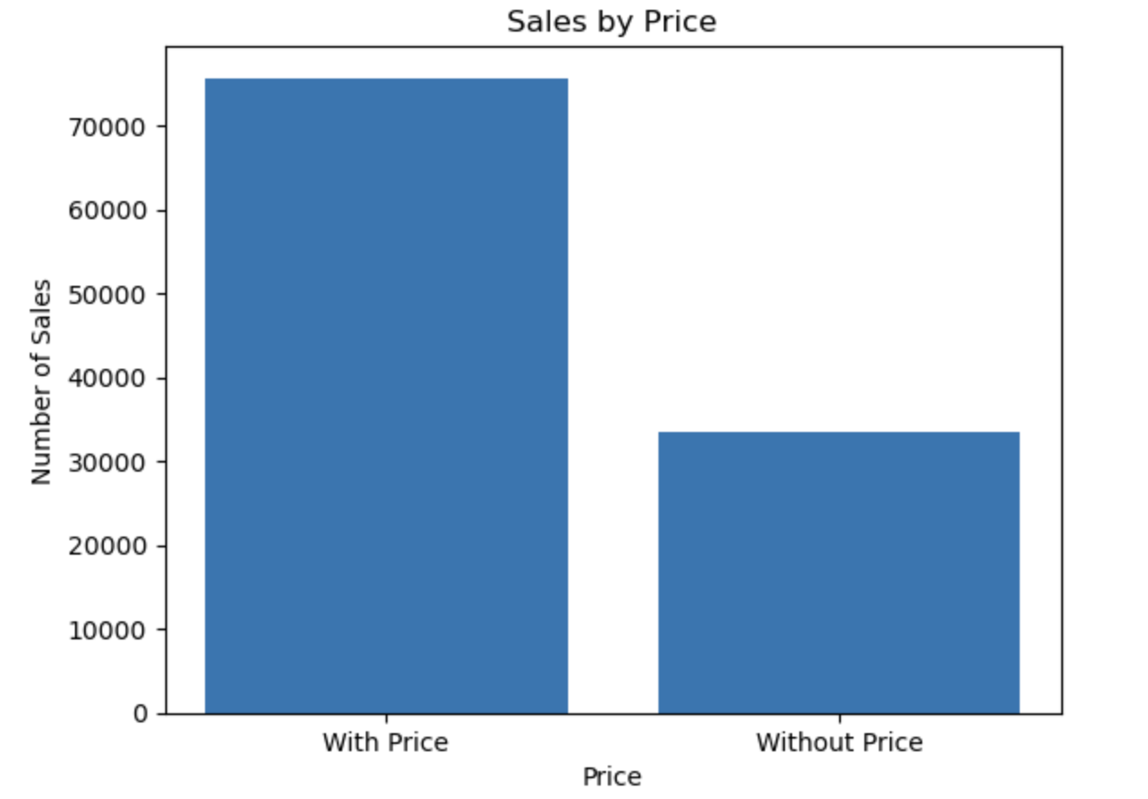
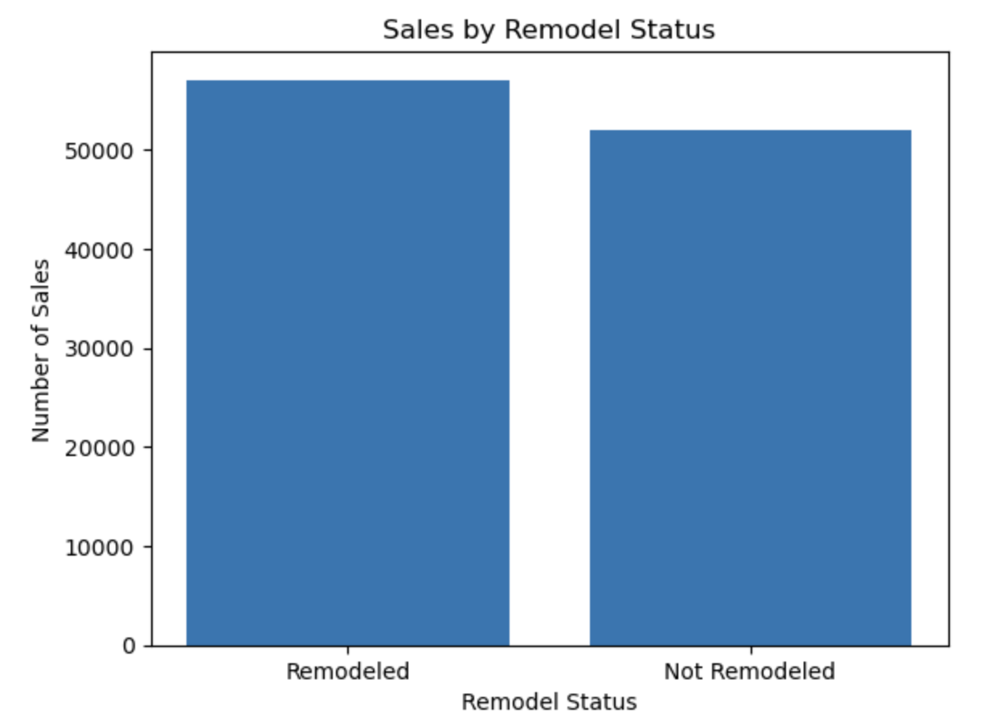
Data Analysis
Annual and Monthly Property Sales Trends
Property Sales by Price and Remodeled Status
Notes:
Note: Remove this slide from your final presentation.
This example architecture diagram shows a solution to configure a webhook to link Git with AWS. You can find this example in the Toolkits for PowerPoint at https://aws.amazon.com/architecture/icons.

Slide 12
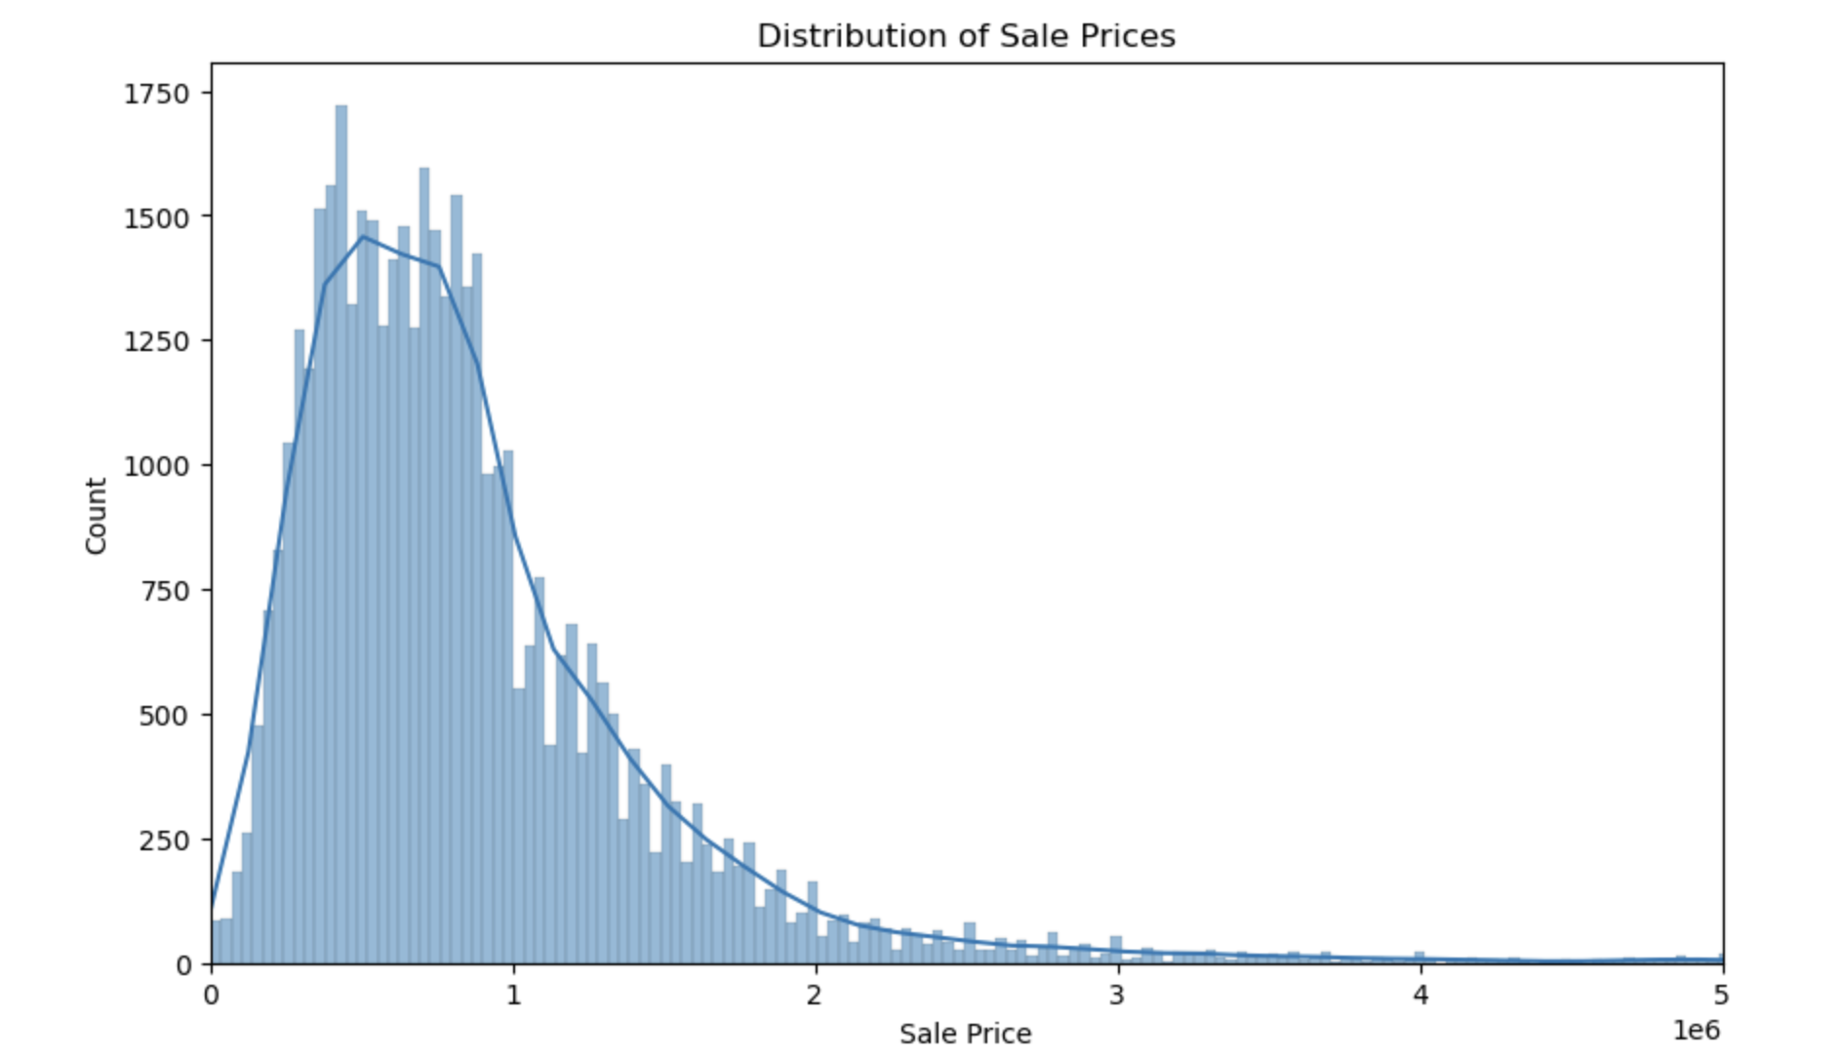
Distribution of Sale Prices for Trimmed Sales Data with KDE Plot
Notes:
Note: Remove this slide from your final presentation.
This example architecture diagram shows a solution to configure a webhook to link Git with AWS. You can find this example in the Toolkits for PowerPoint at https://aws.amazon.com/architecture/icons.

Slide 13
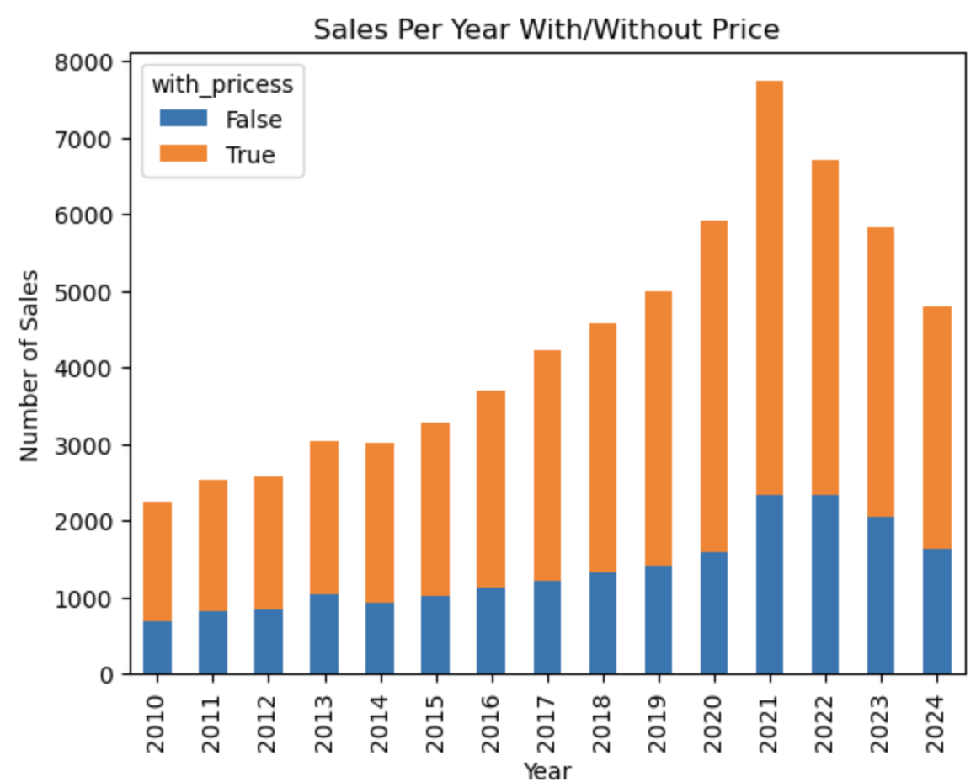
Annual Property Sales Comparison with and without Price
Notes:
Note: Remove this slide from your final presentation.
This example architecture diagram shows a solution to configure a webhook to link Git with AWS. You can find this example in the Toolkits for PowerPoint at https://aws.amazon.com/architecture/icons.

Slide 14
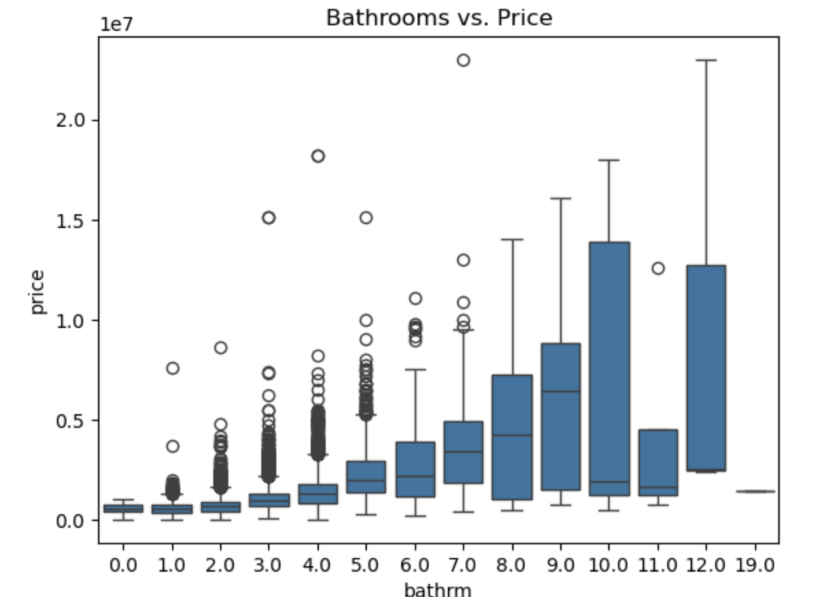
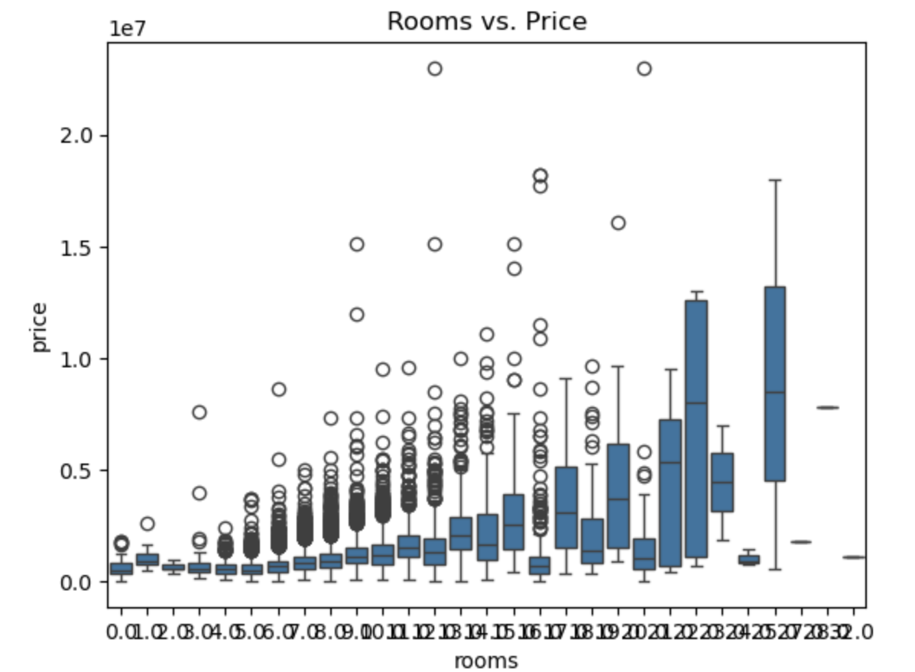
Property Sales by Price and Remodeled Status
Notes:
Note: Remove this slide from your final presentation.
This example architecture diagram shows a solution to configure a webhook to link Git with AWS. You can find this example in the Toolkits for PowerPoint at https://aws.amazon.com/architecture/icons.

Slide 15
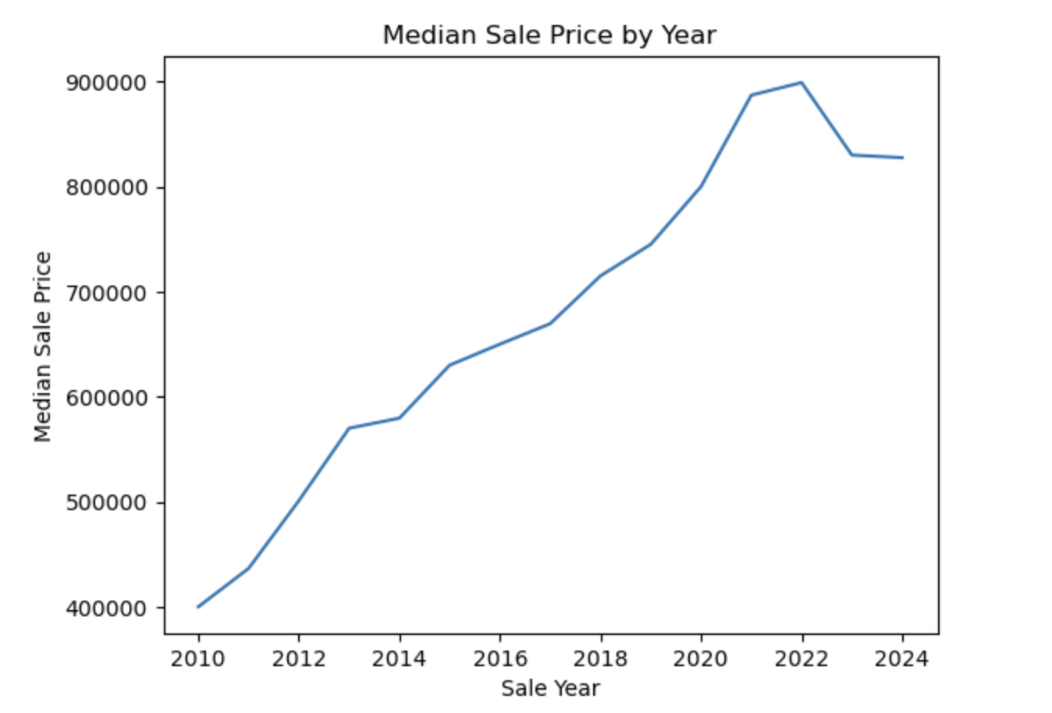
Median Sale Price by Year: Trend Analysis
Notes:
Note: Remove this slide from your final presentation.
This example architecture diagram shows a solution to configure a webhook to link Git with AWS. You can find this example in the Toolkits for PowerPoint at https://aws.amazon.com/architecture/icons.

Slide 16
Modeling
Model: Build LR model: adding cndtn as additional predictor variables
X: bathrm, bedrm, grade, heat, cndtn
Y: price
Mean squared error: 258804844708.28784
R-squared: 0.5784908019353887
Coefficients: [164723.6500079 15967.68634476 313870.40180323 3716.9691146 232647.40605471]
The model with additional predictor variables (heat and cndtn) has lower mean squared error and higher R-squared value, indicating an improved ability to predict sale price of residential properties.
The coefficient for bedrm is 15,967, indicating a positive correlation between the number of bedrooms and sale price.
The coefficient for grade is 313870, indicating a strong positive correlation between the grade and sale price.
Notes:
Note: Remove this slide from your final presentation.
This example architecture diagram shows a solution to configure a webhook to link Git with AWS. You can find this example in the Toolkits for PowerPoint at https://aws.amazon.com/architecture/icons.

Slide 17
Model: Build LR model: adding cndtn as additional predictor variables
X : bathrm, bedrm, grade, heat, cndtn
Y: price
A one-unit increase in the number of bedrooms is associated with a $15,967 increase in sale price.
There is a positive correlation between the number of bedrooms and sale price.
A one-unit increase in grade is associated with a $313,870 increase in sale price.
There is a strong positive correlation between grade and sale price.
Notes:
Note: Remove this slide from your final presentation.
This example architecture diagram shows a solution to configure a webhook to link Git with AWS. You can find this example in the Toolkits for PowerPoint at https://aws.amazon.com/architecture/icons.

Slide 18
Model: Build LR model: Adding gross building area another predictor
X : bathrm, bedrm, grade, heat, cndtn, gba
Y: price
=== Linear Regression Summary ===
Independent variables: ['bathrm', 'bedrm', 'grade', 'heat', 'cndtn', 'gba’]
Dependent variable: price
Training data size: 24499
Test data size: 6125
Mean squared error: 212482373114.2765
R-squared: 0.6539350923078139
Coefficients: [ 45474.64703669 -72781.65407855 221173.8025435 857.96809526 257221.10348558 434.47093989]
Notes:
Note: Remove this slide from your final presentation.
This example architecture diagram shows a solution to configure a webhook to link Git with AWS. You can find this example in the Toolkits for PowerPoint at https://aws.amazon.com/architecture/icons.

Slide 19
Model: Build LR model: Adding gross building area another predictor
Which variables have an impact on sale price, and how strong is that impact? - Is there a correlation between the number of bedrooms and the sale price of a residential property in this dataset? - Is there a correlation between the grade and the sale price of a residential property in this dataset?
Yes, there is a correlation between the number of bedrooms and the sale price of residential properties in this dataset. Interestingly, the correlation is negative, indicating that an increase in the number of bedrooms is associated with a decrease in the sale price.
Yes, there is a positive correlation between the grade and the sale price of residential properties in this dataset. This indicates that as the property grade increases, the sale price tends to increase as well.
Notes:
Note: Remove this slide from your final presentation.
This example architecture diagram shows a solution to configure a webhook to link Git with AWS. You can find this example in the Toolkits for PowerPoint at https://aws.amazon.com/architecture/icons.

Slide 20
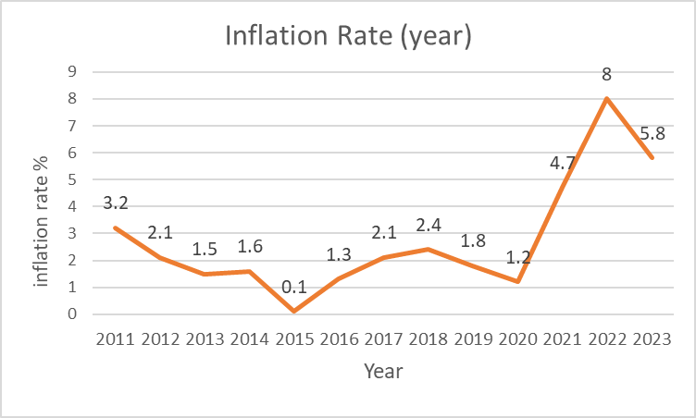
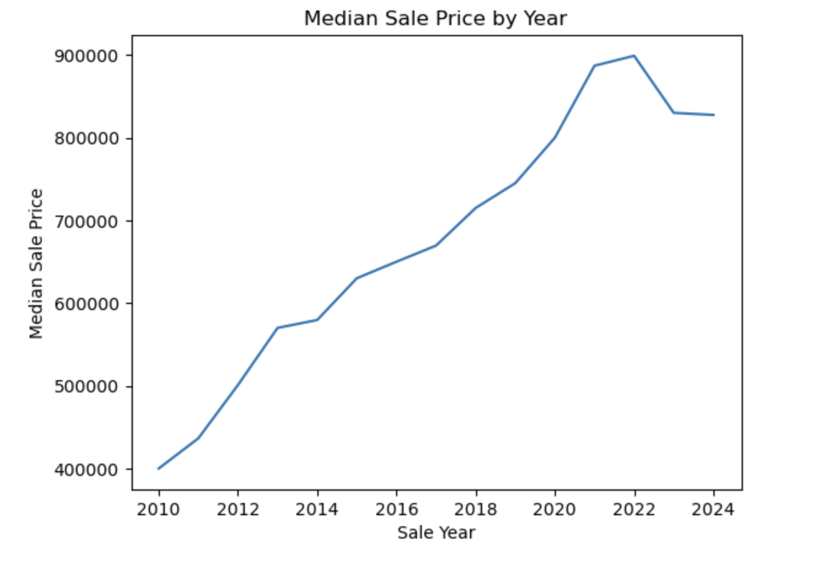
COVID-19 Impact
The analysis period is divided into three distinct phases:
• Before Covid: January 1, 2019 – February 29, 2020
• During Covid: March 1, 2020 – July 31, 2021
• After Covid: August 1, 2021 – December 31, 2023
Significant changes in house prices were observed before and after the COVID-19 event. To minimize the impact of general price fluctuations on house prices, the house prices are adjusted for inflation using the inflation rate.
Notes:
Note: Remove this slide from your final presentation.
This example architecture diagram shows a solution to configure a webhook to link Git with AWS. You can find this example in the Toolkits for PowerPoint at https://aws.amazon.com/architecture/icons.

Slide 21
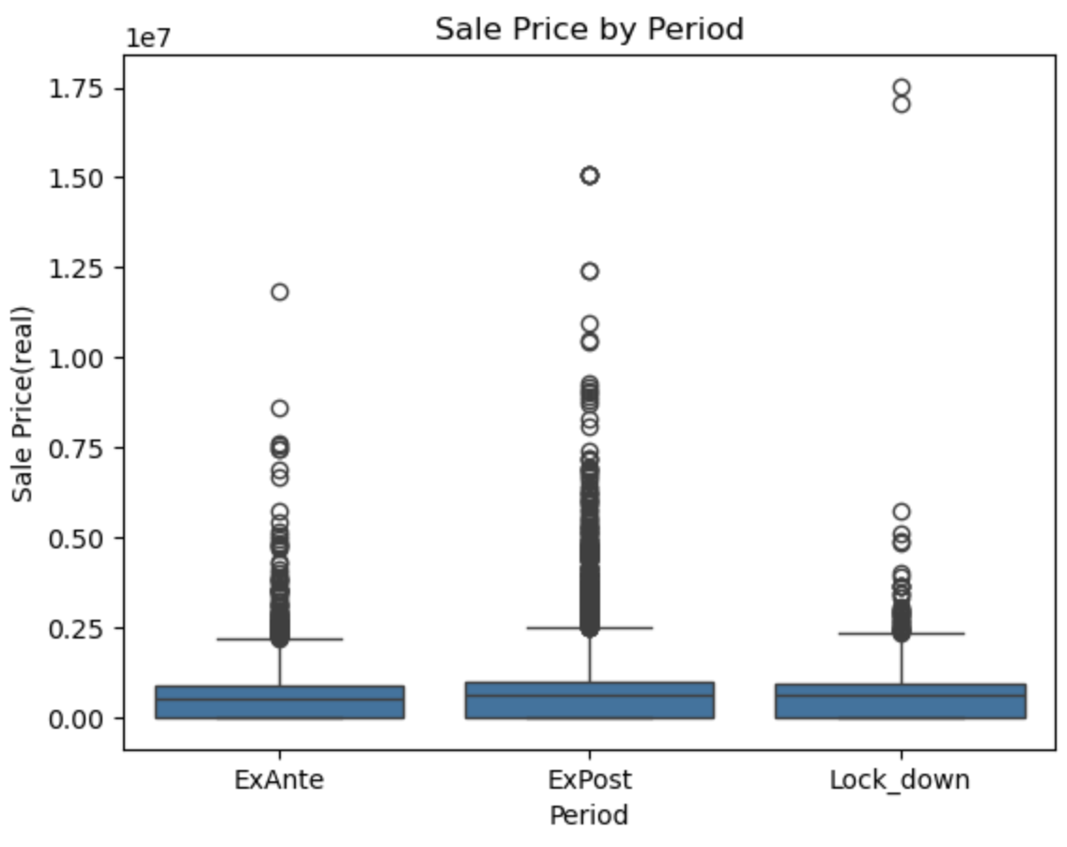
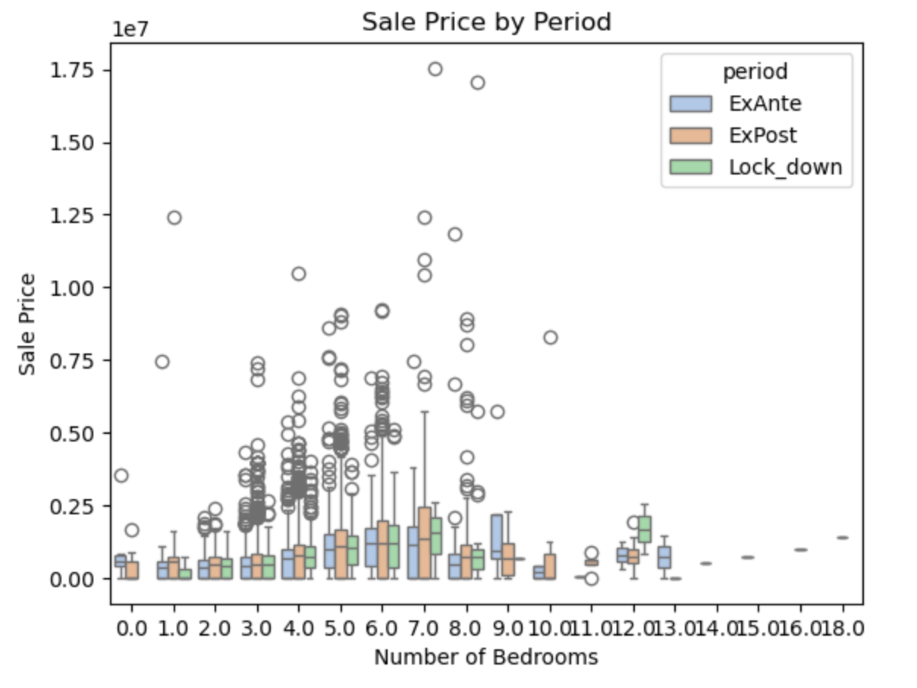
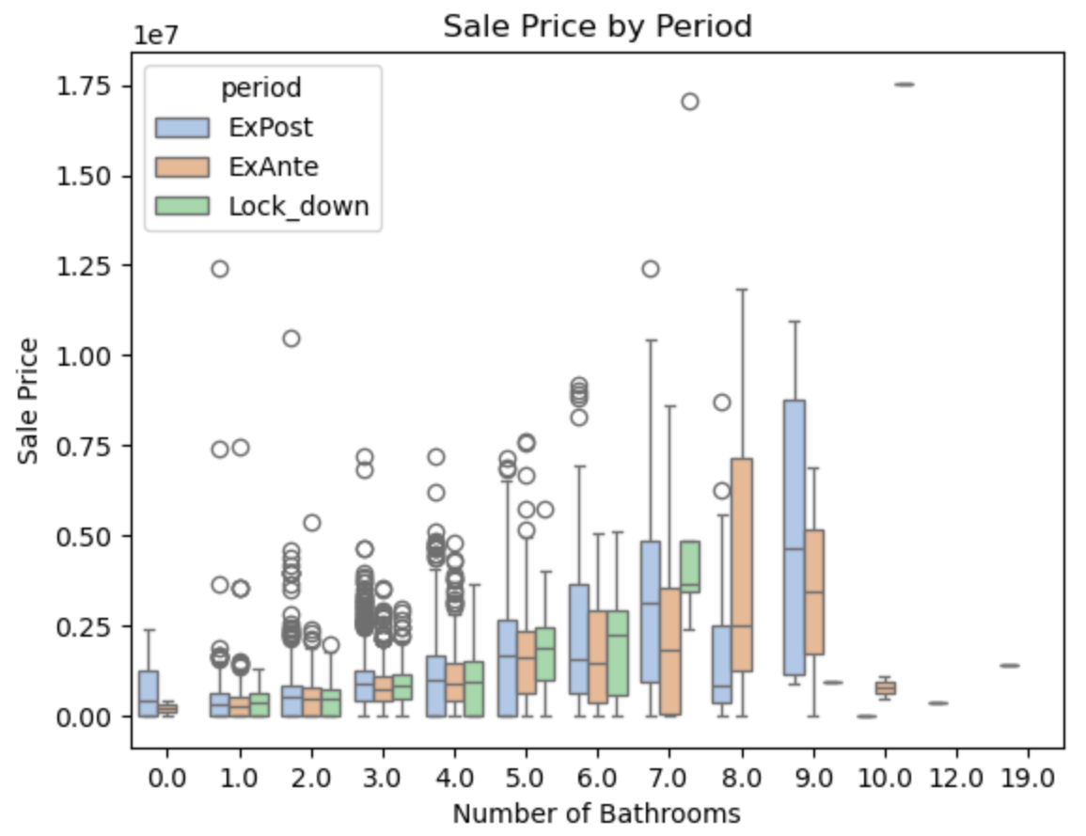
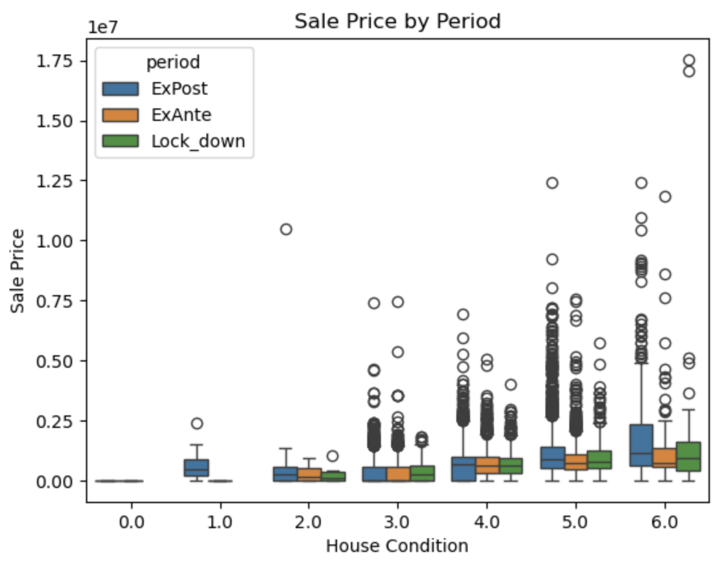
COVID-19 Impact
When comparing house price levels based on the number of bedrooms, number of bathrooms, and overall house condition, distinct price differences are evident across the three periods.
Notes:
Note: Remove this slide from your final presentation.
This example architecture diagram shows a solution to configure a webhook to link Git with AWS. You can find this example in the Toolkits for PowerPoint at https://aws.amazon.com/architecture/icons.

Slide 22
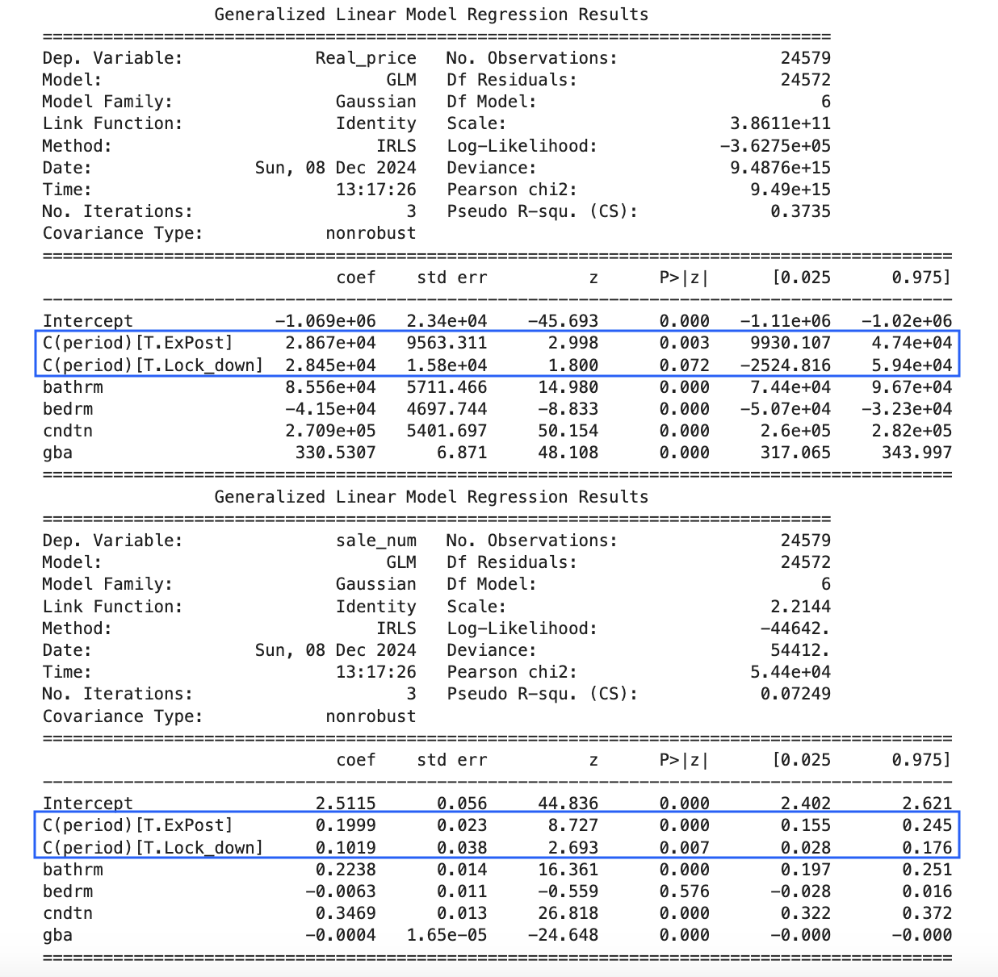
COVID-19 Impact
The Covid period had a positive impact on sales volume, with an increase observed both during and after COVID compared to the pre-COVID period.
Similarly, the Covid period positively influenced housing prices, as prices rose during and after COVID compared to the pre-COVID period.
Notes:
Note: Remove this slide from your final presentation.
This example architecture diagram shows a solution to configure a webhook to link Git with AWS. You can find this example in the Toolkits for PowerPoint at https://aws.amazon.com/architecture/icons.

Slide 23
Covid Impact
What reasons boost the housing market?
1. Remote Work and Lifestyle Changes: With the shift to remote work, many people sought larger homes with office space or moved from urban areas to suburban or rural locations, increasing housing demand in less densely populated areas.
2. Increased Savings and Government Stimulus: Lockdowns reduced spending on travel, dining, and entertainment, leading to higher personal savings. Additionally, government stimulus payments provided people with more disposable income, which some used for down payments on homes.
3. Supply Chain Disruptions and Construction Delays: The supply of new homes slowed due to labor shortages and supply chain issues for construction materials. This limited housing inventory, driving up competition and prices.
4. Desire for More Space and Better Living Conditions: Quarantine and lockdowns prompted many people to seek larger, more comfortable living spaces, especially with the need for home offices, home gyms, and outdoor space.
Notes:
Note: Remove this slide from your final presentation.
This example architecture diagram shows a solution to configure a webhook to link Git with AWS. You can find this example in the Toolkits for PowerPoint at https://aws.amazon.com/architecture/icons.

Slide 24
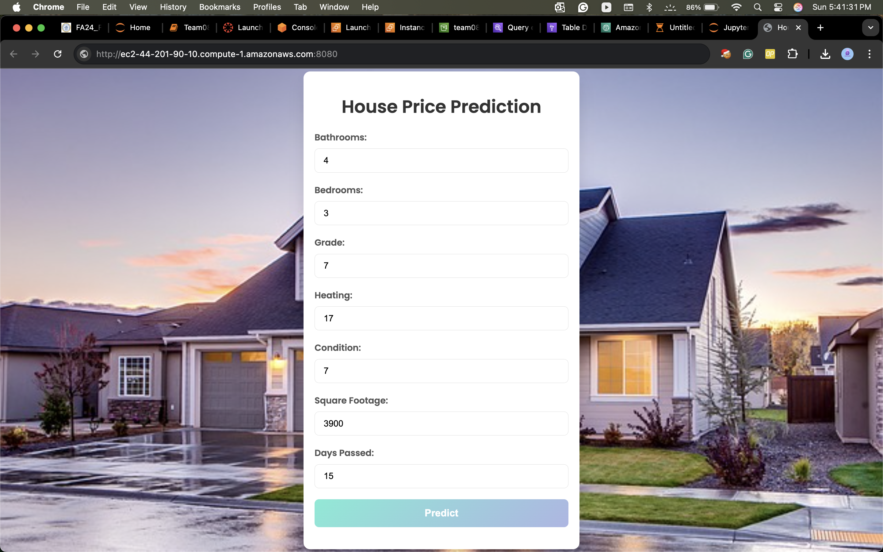
Deployment:
Notes:
Note: Remove this slide from your final presentation.
This example architecture diagram shows a solution to configure a webhook to link Git with AWS. You can find this example in the Toolkits for PowerPoint at https://aws.amazon.com/architecture/icons.

Slide 25
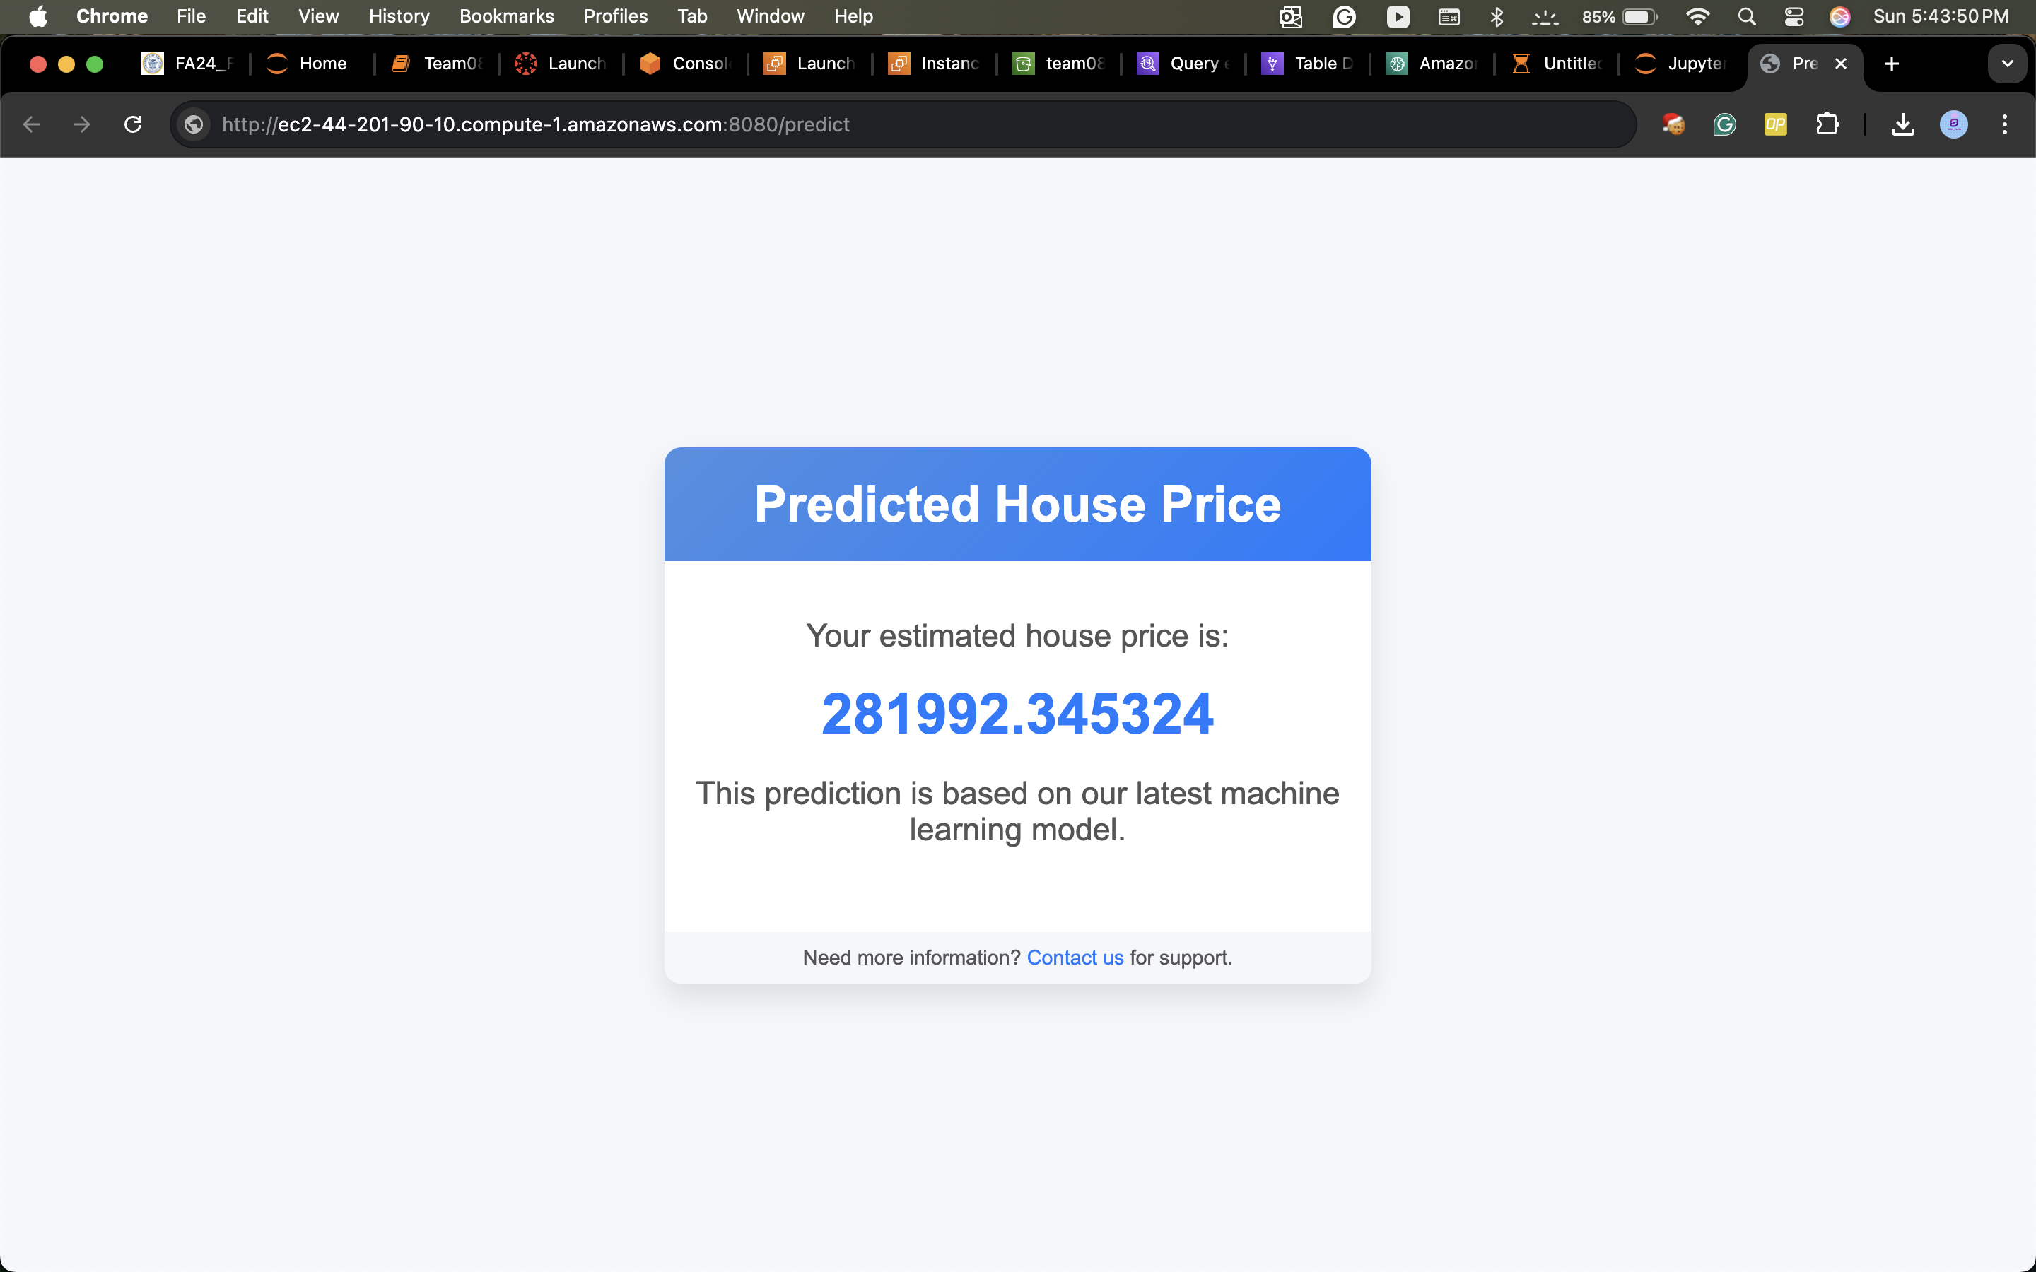
Deployment:
Notes:
Note: Remove this slide from your final presentation.
This example architecture diagram shows a solution to configure a webhook to link Git with AWS. You can find this example in the Toolkits for PowerPoint at https://aws.amazon.com/architecture/icons.

Slide 26

Conclusion
This project analyzed key factors influencing residential property prices, especially during the COVID-19 pandemic. Using CAMA data and CRISP-DM methodology, it identified the impact of property features, location, and pandemic-driven lifestyle changes. Linear regression models with predictors like bedrooms, bathrooms, and gross building area improved prediction accuracy. The analysis revealed rising prices during and after COVID, driven by increased demand for larger homes and supply chain issues. The project highlights the power of data-driven insights for real estate stakeholders to adapt to changing market trends.
Github link: https://github.com/siddureddy-DS/Team08-DSCI-6007-01
Notes:
Note: Remove this slide from your final presentation.
This example architecture diagram shows a solution to configure a webhook to link Git with AWS. You can find this example in the Toolkits for PowerPoint at https://aws.amazon.com/architecture/icons.

Slide 27
Reference:
Dabreo, S., Rodrigues, S., Rodrigues, V., & Shah, P. (2021). Real estate price prediction. International Journal of Engineering Research & Technology, 10(4). https://www.ijert.org/research/real-estate-price-prediction-IJERTV10IS040322.pdf
Akshay Babu, Dr. Anjana S Chandran , "Literature Review on Real Estate Value Prediction Using Machine Learning" , International Journal of Computer Science and Mobile Applications, Vol: 7 Issue: 3, 2019
Géron, A. (2019). Hands-on machine learning with Scikit-Learn, Keras, and TensorFlow (2nd ed.). O’Reilly Media. ISBN: 978-1-492-03264-9.
Duca, J. V., & Murphy, A. (2021). Why house prices surged as the COVID-19 pandemic took hold. Federal Reserve Bank of Dallas. https://www.dallasfed.org/research/economics/2021/1228
Schwartz, A. E., & Wachter, S. (2022). COVID-19’s impacts on housing markets: Introduction. Journal of Housing Economics.
Notes:
Note: Remove this slide from your final presentation.
This example architecture diagram shows a solution to configure a webhook to link Git with AWS. You can find this example in the Toolkits for PowerPoint at https://aws.amazon.com/architecture/icons.

Slide 28
Thank you

